Slide 1
Updated FY15 Dignity Health General Compliance Education for Providers Module 2
This course will provide you with important information about the laws and regulations that affect the healthcare industry, our organization and you.

Slide 2
Module Objectives
Upon completion of this module, you should be able to understand and describe:
What is PHI
The difference between Use and Disclosure
Patient’s rights under HIPAA
Who is a Business Associate
Appropriate uses of the Dignity Health network
How to send a secure e-mail
Your reporting obligations

Slide 3
Privacy

Slide 4





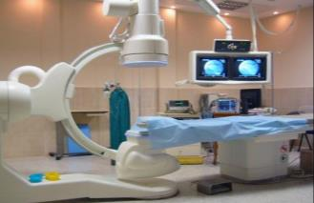




The healthcare industry is becoming more interconnected
Medical Services
Health Plans
Pharmacies & Drug Companies
Hospitals
Physicians & Medical Practices
Medical Devices
Research
Medical Records
EMRs & HIEs
Human Resources
Patient privacy and data are more at risk

Slide 5
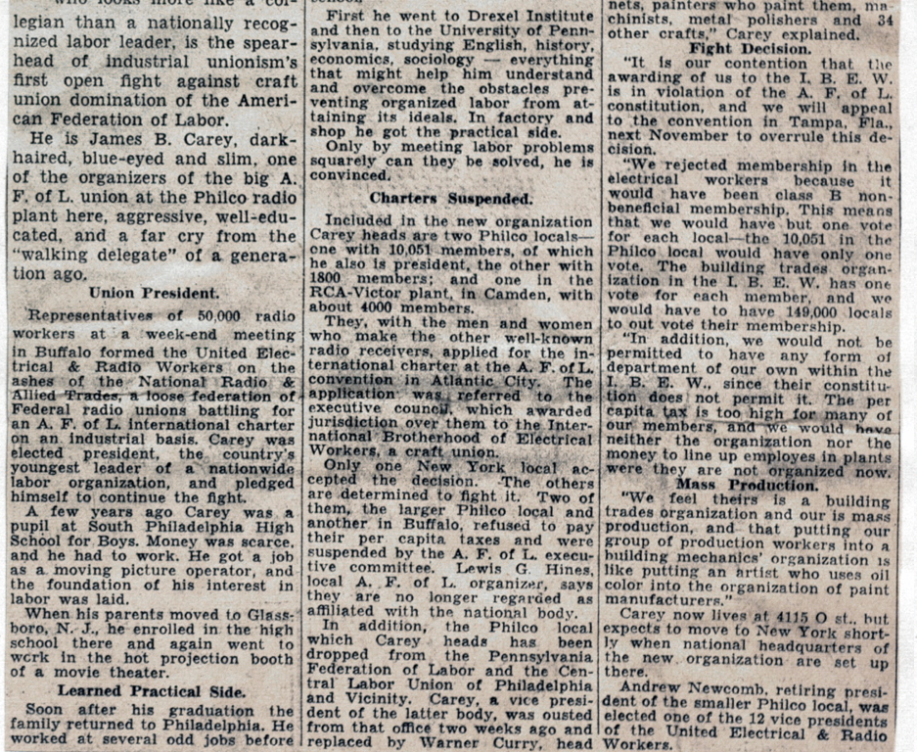
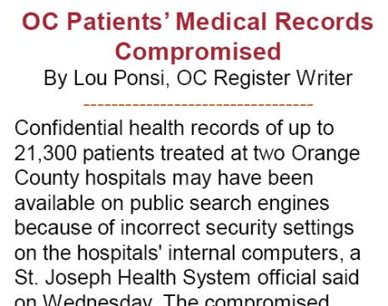
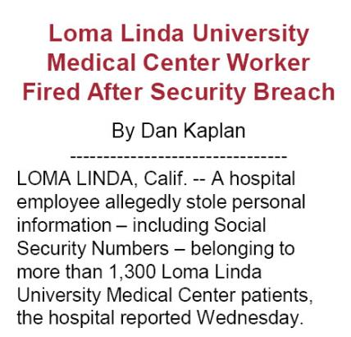
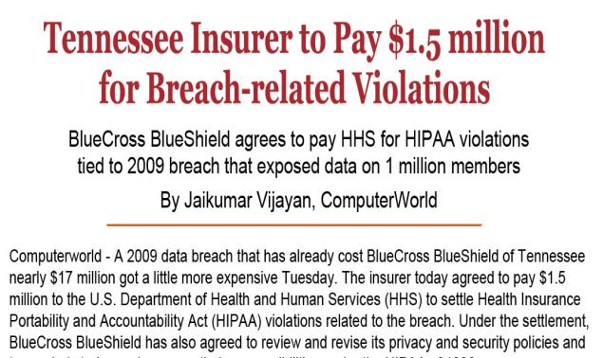
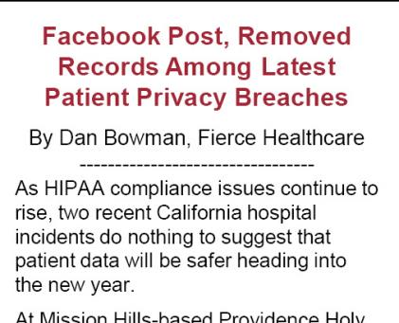
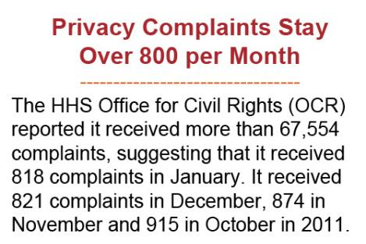
Privacy and Data Security Breaches Happen Every Day
5

Slide 6

A Message From Lloyd Dean
Responsible use of data and privacy compliance is essential to the mission of Dignity Health.
The laws and rules that apply to the delivery of healthcare are often complex.
As part of management, it is imperative that we always hold ourselves accountable for the decisions we make and the actions we take.
A Proactive approach to privacy and data security will impact the bottom line by ensuring consumer confidence and trust, which is a strong competitive advantage. We can achieve this competitive business advantage by embedding our privacy and data security policies and procedures into your daily business practices.
We need your help and commitment to protect patient and confidential information.
6

Slide 7
Regulatory Overview
7

Slide 8
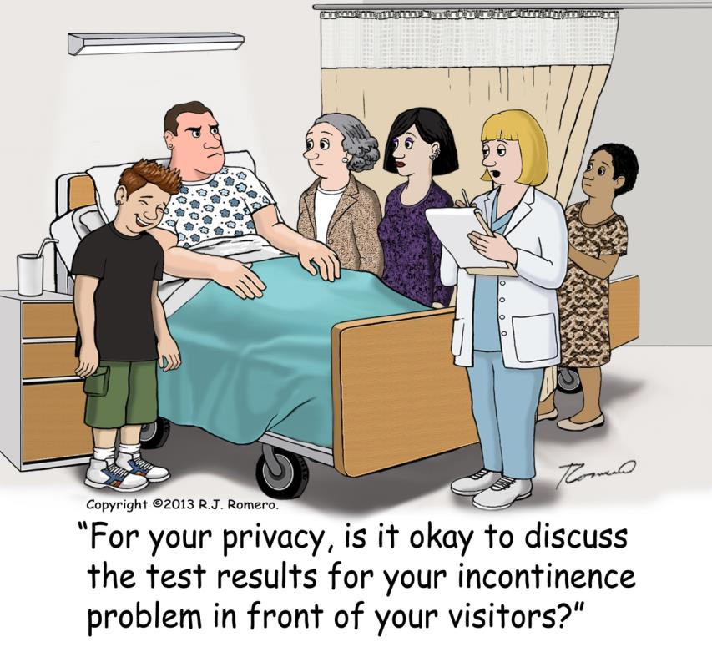
HIPAA

Slide 9
HIPAA Regulations
The Health Insurance Portability & Accountability Act (HIPAA) is managed by the Office of Civil Rights (OCR)
Health
Insurance
Portability &
Accountability
Act
HIPAA regulations include controls for the use and disclosure of Protected Health Information (PHI).
Use: when PHI is used internally for Treatment, Payment or other Healthcare Operations (audits, training, customer service, internal analysis, etc.).
Disclosure: to release or provide access to a patient’s PHI to someone like a physician, an attorney, insurance company, etc., outside of Dignity Health.
Notes:
9

Slide 10
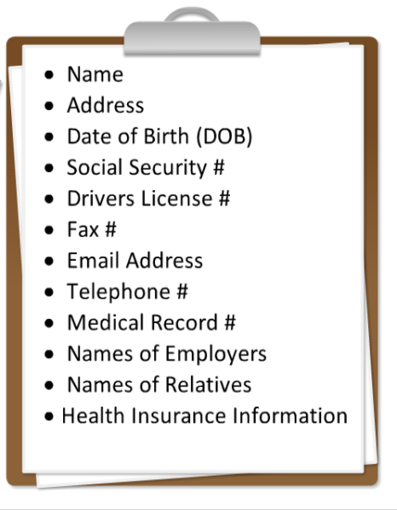
Protected Health Information (PHI)
PHI is any individually identifiable information in any form that provides a reasonable basis to identify an individual.
Even if the information does not directly identify a person, if it can be used to identify a person, then it is PHI.
PHI includes any name, number, code, image, or any data element that can be used directly or indirectly to identify an individual, including
name
date of birth
phone number
Photographic or other images
name of employer
any other data element that can be used to identify an individual
Notes:
10

Slide 11
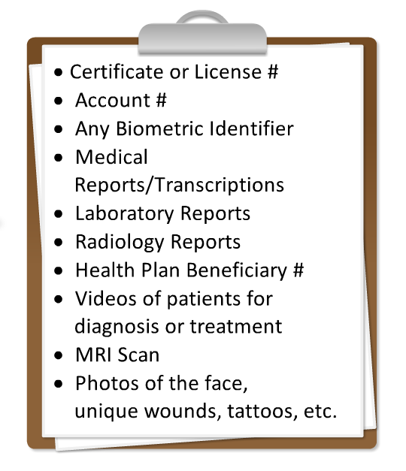
Protected Health Information (PHI)
PHI is not just the patient’s medical record - PHI comes in many forms:
Paper records of all types
Documents and forms
Doctors orders
Labels on patient care items
Photos and graphics
Electronic records
computer-based records
Biomedical equipment
portable storage media
video recordings
Verbal/Oral communications
Observation
11
Notes:
11

Slide 12

Patient’s Rights under HIPAA
All Patients have a right to:
Inspect and/or get a copy of their medical record
An Accounting of Disclosures - Patients at any time can ask us to provide them with a list of everyone we have released their health records to, for a period of 6 years.
Request a Restriction
Request an alternative means of communication
Request an amendment
All inpatients have the right to Opt-Out of the facility directory

Slide 13
Notice of Privacy Practices
The Notice of Privacy Practices (NPP) document is displayed in a prominent location and made available to all patients to help them understand their rights under HIPAA. The NPP informs the patient of:
Our pledge to keep their information private.
How information about them may be used or disclosed in the process of treatment, collecting payment, and improving healthcare operations.
Remedies they may seek under the law if they feel their rights have been violated.
Reference Dignity Health Policy: 110.1.019 Notice of Privacy Practices

Slide 14

Treatment, Payment and Operations (TPO)
A patient’s written authorization is required for most uses or disclosures of PHI except for treatment, payment and operations (TPO).
Treatment: Disclosing necessary information to other providers who are involved in treating the patient.
Payment: Disclosing necessary information to health plans, insurers, others for the payment of health care provided to the patient. You must limit disclosure to the minimum necessary. If more information than necessary is on the patient record you must remove it.
Operations: Use of health information for quality improvement, care management, patient satisfaction studies, accreditation, and education.

Slide 15

Written Authorization Required for Use or Disclosure of PHI
For any use or disclosure outside of TPO, we need the patient’s signed authorization. For example:
To participate in the Facility Directory
To share PHI with family and friends who are not the Medical Power of Attorney
To disclose PHI to a pharmaceutical company
If a lawyer wants PHI for a lawsuit
To life insurance companies
For disability determination
Research and studies
Marketing communications/news media
Fundraising using the patient’s health information
Release of sensitive PHI such as HIV/AIDS test results; substance abuse; mental health; and developmental disability.
Notes:
15

Slide 16

110.1.005 Facility Patient Directory Policy
Patients may restrict or prohibit some or all uses of their information in the facility directory.
Facility directory may contain only:
Patient Name
Facility Location
Condition (using one-word general terms)
Religious Affiliation (provided only to visiting clergy)
Patient information will be provided only when the request is for information by patient name.
Religious affiliation may be disclosed only to visiting clergy.
Visiting clergy may access directory information without patient name.

Slide 17

Incidental Uses & Disclosures of PHI
Incidental means a use or disclosure that cannot be reasonably prevented, is limited in nature, and occurs as a by-product of an otherwise permitted use or disclosure.
For example:
discussion with a patient in a semi-private hospital room.
calling a patient’s name in waiting room.
discussions during teaching rounds.
sign-in sheet in a clinic or hospital.
Incidental uses and disclosures are permitted under HIPAA, as long as reasonable safeguards and Minimum Necessary standards are used to protect PHI.
17
Notes:
17

Slide 18

110.1.012 Use & Disclosure of PHI as Required by Law
Disclosures to law enforcement and government authorities may not require an authorization.
Any such disclosure must be limited to requirements of applicable law.
Verify the identity and authority of agency or individual making the request.
Requests for PHI by law enforcement officials must be included in an Accounting of Disclosures.
Examples of disclosures:
Public Health Activities
Victims of Abuse
Judicial Proceedings
Organ procurement
Purposes of security or safety
Disaster relief

Slide 19

110.1.013 Patient’s Family and Friend Policy
You may disclose PHI to members of the patient’s family, friends, or any other person identified by the patient as being involved in their care or payment, if the patient has agreed to the disclosure.
Disclose only PHI that is directly relevant to the involvement of the family member or friend with the patient’s care or related payment.
Use professional judgment about disclosing PHI in an emergency or when patient is unable to express agreement.
You may disclose a patient’s location, general condition, or death in order to notify, identify or locate a family member or personal representative of the patient.

Slide 20

110.1.017 Research Use and Disclosure of PHI Policy
The I.R.B. (Institutional Review Board) may not authorize the use or disclosure of PHI for research purposes except:
If Dignity Health facility has obtained a valid authorization from the individual subject of the information; or
If the I.R.B. approves a waiver of the individual authorization requirement.
For reviews preparatory to research;
For research on the PHI of a decedent;
If the information is completely “de-identified”;
If the information is partially de-identified into a “limited data set” and the recipient of the information signs a data use agreement to protect the privacy of the information.
Notes:
20

Slide 21
HITECH Act - Expands HIPAA
Effective January 1, 2009 the HITECH Act is the privacy and data security component of the American Recovery and Rehabilitation Act (ARRA)
Health
Information
Technology for
Economic and
Clinical
Health
Enforced by the Office of Civil Rights (OCR) of the Department of Health & Human Services.
Additional enforcement is granted through state Attorneys General to order actions and obtain damages on behalf of individuals.
HITECH applies HIPAA standards and penalties to Business Associates.
Increased penalties for HIPAA Violations
Maximum penalty per violation increases from $100 per violation to $50,000 maximum.
The cap on penalties for all similar violations increased from $100,000 to $1,500,000.
Makes individuals subject to penalties.
21
Notes:
21
21

Slide 22

Business Associates
Dignity Health uses the services of other businesses or individuals to help carry out our healthcare activities and business functions.
Business Associates (BA) - third party vendors and business partners that help Dignity Health carry out healthcare activities, exchange data with Dignity Health and perform business functions like medical groups, auditors, lawyers, consultants, claims-processing firms, benefits management, transcription services, paper storage companies, data centers, etc.
Your responsibility as a health care provider includes ownership and responsibility for any contracts sponsored by your department, as well as ensuring there is a privacy review before releasing any information to a third party.
Notes:
22
22

Slide 23
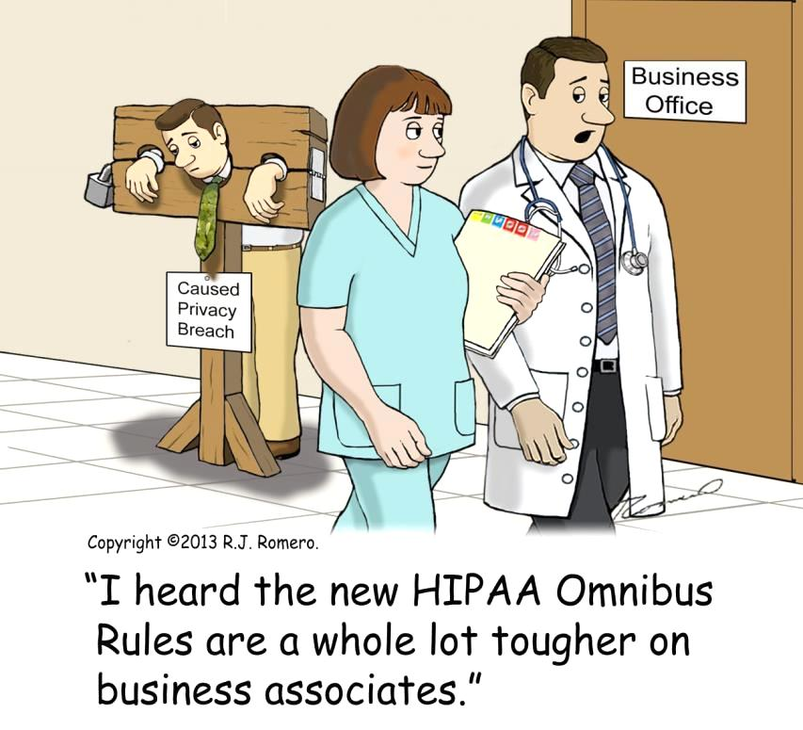
110.1.011 Business Associate & Classified Information Policy
When the activities of a BA involves the use or disclosure of Protected Health Information (PHI) the BA is subject to HIPAA.
BAs must provide written assurance to Dignity Health that:
the BA will use the information only for authorized purposes, and safeguard the information from misuse;
the BA will comply with all HIPAA and state privacy and data security regulations.
Under the HITECH Act, BAs are responsible for compliance with HIPAA, as well as having the same liability for HIPAA violations as any covered entity.

Slide 24
California Privacy Laws
California Health & Safety Code 1280.15 (SB541) impacts all Dignity Health facilities.
Prohibits unauthorized viewing, use or disclosure of medical records without direct need for diagnosis, treatment or other unlawful use.
Requires healthcare organizations to prevent, detect, and investigate unlawful or unauthorized access, use or disclosure of patient medical information.
Requires that breaches be reported to the California Department of Public Health (CDPH) and affected patient(s) within 5 business days of discovery.
The alleged violator’s name is required as part of reporting.
Authorizes penalties:
$25,000 per patient up to $250,000
$100 per day for failure to report.
24
Notes:
24
24

Slide 25

California Privacy Laws
Health & Safety Code 130200 (AB211) impacts both Healthcare providers & individuals.
Creates the California Office of Health Information Integrity (OHII) authorized to impose fines for violations.
Provides private right of action for patients to seek damages as a result of privacy incidents.
Places liability directly on the individual who knowingly, willfully or negligently obtains, discloses or uses medical information inappropriately with penalties from $2,500 to $250,000 per violation.
25
Notes:
25
25

Slide 26
The Reality of Privacy Breaches for Dignity Health
Regardless if you work at a business office or hospital, all employees are affected by the consequences of privacy & data security breaches.
The alleged violator’s name is required as part of the reporting to CDPH, and CDPH will want to interview the employee(s) involved.
In September 2012, CDPH sent out letters notifying 3 Dignity Health facilities that they were being fined for privacy and data security breach incidents, which we had reported to CDPH as far back as 2009.
For an incident in March 2009, a Dignity Health Facility was fined $100,000.00. The incident involved an EKG technician who inappropriately accessed the records of family members without the necessary authority. CDPH referred this individual to the Office of Health Information Integrity who separately investigated and fined the employee.
26
26
Notes:
26
26

Slide 27
Protecting Information
27

Slide 28

What Other Information Must You Protect?
Even if you do not deal with patient information directly, Sensitive or Confidential information should be treated with the same precautions as PHI.
Sensitive Information - This classification applies to Protected Health Information (PHI), Individually Identifiable Health Information (IIHI), Personal Information or credit card information.
Confidential information
Data that is not classified as PHI, but is deemed confidential by law, rule, regulation, or would otherwise be considered confidential based on Dignity Health policy or practices, including:
Dignity Health employees
Job applicants
Workers Compensation
Fund raising contacts
Dignity Health financial information
Notes:
28

Slide 29

Confidentiality & Data Classification Policy
Dignity Health Policy 110.1.039 details the types of data classification and who may receive the data.
Managers are responsible for ensuring employees are educated on departmental procedures for data classifications:
PHI
Internal Use Only
Sensitive
Confidential
Strictly confidential
Departmental procedures should address both physical and technical safeguards for storage, disposal, and transmission of sensitive information (electronic or paper) outside of your department.

Slide 30

Safeguarding PHI & Sensitive Information
Protecting patient privacy and confidential information means practicing some basic safeguards in your work area.
Do not leave documents with PHI or confidential information unattended on fax machines, printers or copiers.
Never allow removal of PHI or other confidential information from the facility without authorization and appropriate security measures.
Store portable media that contains PHI or Confidential information in a locked drawer or cabinet.
Notes:
30
30

Slide 31
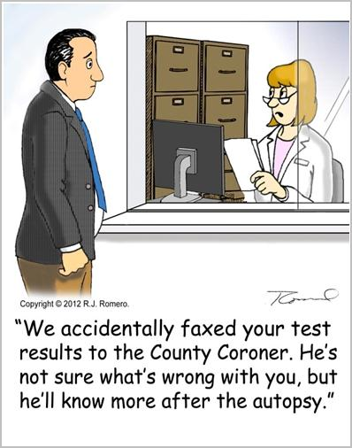
Safeguarding Faxes and U.S. Mail
Misdirected faxes are the #1 reported privacy incident across Dignity Health.
Everyone must use a Dignity Health fax coversheet when faxing PHI or other confidential information.
Always verify the recipient’s fax number before sending (including preprogrammed number).
Report any misdirected fax or U.S. mail to your local Facility Compliance Professional (FCP).
Reference Policy 110.1.014 Safeguarding PHI and Sensitive Information
Notes:
31

Slide 32

110.1.015 Minimum Necessary Standards Policy
HIPAA’s Privacy Rule requires that you must make a reasonable effort to limit the use, disclosure or release of PHI to only the Minimum Necessary amount of data elements that are necessary to accomplish the intended purpose.
Dignity Health workforce members must apply Minimum Necessary standards when PHI must be disclosed or provided to someone outside of Dignity Health. (for example, an attorney, contractor, business associate, auditor, etc.)
Only share PHI with authorized personnel who have a need to know.
Minimum Necessary does not apply to use or disclosure of PHI for treatment purposes.
Notes:
32

Slide 33

Safe Disposal of PHI and Confidential Information
PHI must be kept confidential even when it is thrown away.
Paper records with PHI should be shredded or disposed of in a manner that the PHI can not be read or reconstructed (shredded or put in a locked shredder bin).
Pill bottles or patient care items with labels that contain patient information should be destroyed and never put in a recycle bin or garbage can.
Electronic media (CDs, DVDs, backup tapes, etc.) that contain PHI or confidential information must be cleared, overwritten or destroyed so that the information can not be retrieved.
Notes:
33
33

Slide 34
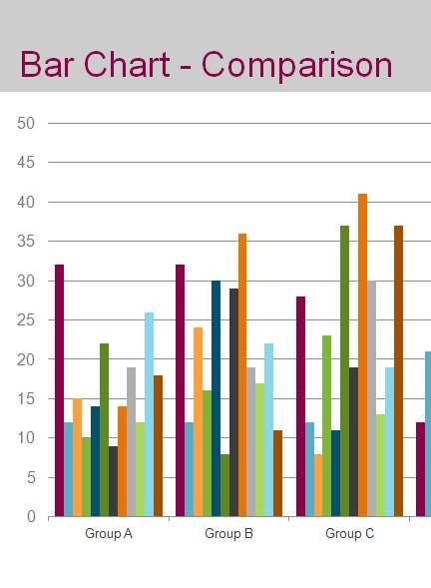
What Would You Do?
While working on a PowerPoint presentation for a meeting, you use a spreadsheet with patient information from hundreds of electronic health records to create a chart, and then embed the chart and spreadsheet in one of the slides.
Is this permitted by HIPAA?
Yes, if you get a signed authorization from each of the patients in order to use their PHI
No, HIPAA does not permit the use of PHI for presentations.
Yes, if you apply Minimum Necessary standards or can de-identify the data
34
Notes:
34

Slide 35
Try Again
Be mindful of how you use PHI and confidential information. An embedded spreadsheet with PHI can be accessed and used to identify individuals. Always use Minimum Necessary standards to remove patient data that is not absolutely necessary to accomplish the task or de-identify the data before creating a chart
Try Again

Slide 36
Correct!
C. Yes, if you apply Minimum Necessary standards or de-identify the data.
Be mindful of how you use PHI and confidential information. An embedded spreadsheet with PHI can be accessed and used to identify individuals. Always use Minimum Necessary standards to remove patient data that is not absolutely necessary to accomplish the task or de-identify the data before creating a chart. Set the presentation’s security so no one can access the embedded spreadsheet.
Continue
36
Notes:
36

Slide 37

Responsible Data Use Practices
Always know the classification of the data you are working with as described in 110.1.039 Confidentiality and Data Classification policy.
What category does the activity fit into? (i.e. Marketing, philanthropy, case management, care coordination, alternative treatments, etc.)
Follow the policies that cover access to or use of sensitive data.
It is your responsibility to limit access to confidential information and don’t rely on the technology to stop you or your staff.
Practice the Minimum Necessary standards for use and disclosure of Protected Health Information (PHI).
Know the process for provisioning and terminating employee or contractor access to Dignity Health network applications.

Slide 38

Marketing Communications and Sale of PHI 110.1.021
“Marketing” means to make a communication about a product or service that encourages recipients to purchase or use the product or service.
Dignity Health policy requires that each new or proposed marketing activity be reviewed by the Director of Marketing and the FCP.
To send a marketing communication to a patient, a signed “Authorization for Use or Disclosure of PHI for Marketing and /or Media Release” form must be obtained first from each individual unless it meets one of the exceptions outlined in the policy.
You must obtain a signed "Authorization for Sale of PHI “ form from each patient for any exchange of PHI when there is direct or indirect payment (remuneration) by a third party.

Slide 39
Philanthropy – Use & Disclosure of PHI Policy 110.1.020
Previously, the HIPAA Privacy Rule required that a covered entity make reasonable efforts to ensure individuals who opt-out do not receive further communications. The HIPAA Omnibus Rule toughened that standard by making it a violation of the HIPAA Privacy Rule for any fundraising communications with a person who has opted out.
Although the Omnibus Rule permits a covered entity to use or disclose certain limited PHI without an authorization for purposes of raising funds for its own benefit, a covered entity is now required to include in each fundraising communication a clear and conspicuous opportunity for the individual to whom the PHI relates to opt out of receiving further fundraising communications.

Slide 40
Philanthropy – Use & Disclosure of PHI Policy 110.1.020
Once an individual opts out, the covered entity may not send fundraising communications to that individual.
Without a written authorization, you must limit use or disclosure of PHI to these data elements:
Name
Address
Phone number
E-mail address
Age (not date of birth)
Gender
Insurance status
Race
Dates of service

Slide 41

What Do You Think?
Dignity Health contracts with third party vendors that perform business functions for and exchange data with Dignity Health.
Which one of the following qualifies as a Business Associate?
A vendor that collects data necessary to assess service lines in hospitals to determine operational efficiency
Direct mailing service that sends marketing material for medical services to former patients
Both of these qualify as Business Associates
41

Slide 42
Try Again
Under the HITECH Act, third party vendors that exchange patient data with Dignity Health qualify as Business Associates.
Try Again

Slide 43
Correct!
C. Both of these qualify as Business Associates
Under the HITECH Act, third party vendors that exchange patient data with Dignity Health qualify as Business Associates. Vendor contracts should always go through a review by a Dignity Health attorney to ensure there are appropriate HIPAA compliant Business Associate provisions in the Master Services Agreement.
Continue
43
Notes:
43

Slide 44
Security

Slide 45

Data Security
Dignity Health is required to monitor and detect any potential privacy or data security breach, including regularly monitoring user network activity.
Attempts to bypass or override any privacy or data security safeguards to access PHI is a violation of Dignity Health’s policies.
It is the responsibility of all Dignity Health network users to safeguard and protect ePHI.
Information is a valuable Dignity Health asset.

Slide 46
Network Usage Policy 110.1.050 (NUPP) for Providers
Dignity Health Network access is a privilege that is granted to users to facilitate the performance of Dignity Health business.
Dignity Health regularly monitors user activity.
The contents and history of a user’s network activity are the property of Dignity Health.
Any content a user creates or receives via the network is not private nor personal.
This includes:
Web browsing
Email and Instant messages
Application activity

Slide 47
Network User Responsibilities
As a user of the Dignity Health network, you are responsible for all activity under your user name, and for using appropriate safeguards to protect the privacy and security of all data.
Memorize your passwords and never share with anyone.
Log out of all workstation computers when leaving unattended or at end of work day.
Set your computer screen to “locked” when you step away from your workstation to avoid unauthorized access.
Comply with Dignity Health IT requirements for anti-virus protection, encryption, and other computer settings used to safeguard the network on your desktop, laptop or any other device used to connect to the network.

Slide 48
Shared Network Drives
Per 110.1.037 Network Usage Policy, all Dignity health Network users are responsible for protecting the privacy and confidentiality of data by following security protocols for shared network drives.
Documents in shared department network drives can be seen by any individual who has access to the drive.
Access to network drive folders that contain PHI or sensitive information should be limited to authorized users.
The IT Help Desk can set up restricted access to folders on a shared drive for authorized users.

Slide 49

Inappropriate Access & Snooping
PHI may not be accessed without a legitimate business purpose.
In order to ensure compliance with regulations, Dignity Health requires employees to follow the same authorization procedures as patients.
It is a violation of Dignity Health policy to use your network access to review your own medical record, PHI of a family member or other individual without the proper authorization.
Inappropriate access of PHI will result in disciplinary action per HR policy 120.1.006.
Protecting PHI is everyone’s job. PHI is not everyone’s business.
Being Snoopy Can Get You In The Doghouse
415-438-5565
SNOOPY
Notes:
49

Slide 50
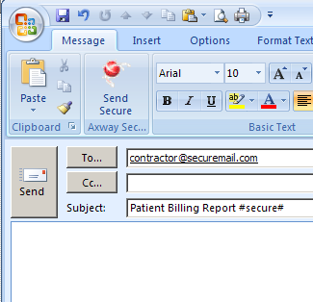
110.1.046 Email Policy and Sending Secure Email
Any PHI or confidential information sent outside of the Dignity Health network requires encryption.
Insert a space after the subject, then type #secure# (lower case).
If a message is sent without the #secure# tag it will not be encrypted and this may be a reportable incident.
You may use the “Send Secure” button if available in your Outlook version.
Notes:
50

Slide 51
Signature Block & E-Mail Confidentiality Statement
When creating your Signature Block and confidentiality statement, you must also comply with the Dignity Health Branding guidelines.
Branding guidelines can be found at: brand.dignityhealthmember.org
Click Employee Access
Sign in with your network User ID and Password
Preferred Name Title Department
Dignity Health Hospital Name Street Address City, State Zip 555.555.5555 (O) 555.555.5555 (M) 555.555.5555 (F) Primary.Email@DignityHealth.org Caution: This email is both proprietary and confidential, and not intended for transmission to or receipt by any unauthorized persons. If you believe that it has been received by you in error, do not read any attachments. Instead, kindly reply to the sender stating that you have received the message in error. Then destroy it and any attachments. Thank you.

Slide 52
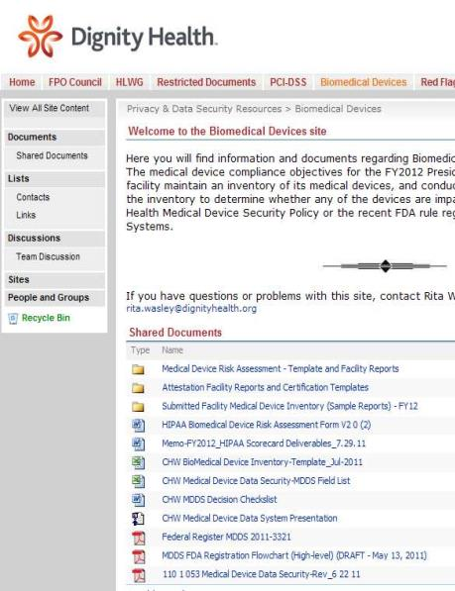
SharePoint Sites
SharePoint sites are a great tool for sharing information, but are not authorized for posting, sharing, or storing documents with PHI or sensitive information.
Technical controls cannot be enforced on a global level due to the varied uses of the sites.
If it is discovered that a document with PHI or sensitive information is posted in a SharePoint site, the site administrator should:
Contact the individual user who posted the document and/or their supervisor to alert them that PHI or sensitive documents should not be posted.
Site administrator should promptly notify the FCP.

Slide 53

What Should You Do?
Heather, one of your direct reports, notifies you that she is going on vacation and will be training Kathy, a coworker in a different role, to cover some of her duties by working with patient records in an application. She lets Kathy sign into the application by using Heather’s user name and password to access the data. What should you do?
Tell Heather to do a thorough training so Kathy does not make any mistakes with the patient information.
Notify the FCP that Kathy will temporarily access the application with patient data.
Ask Heather to contact the IT Help Desk to obtain access for Kathy to the application as it is against policy to share passwords.
53

Slide 54
Try Again
You should never share or keep your password stored under a keyboard or any where in your work area where it might be found easily.
Try Again

Slide 55
Correct!
C. Ask Heather to contact the IT Help Desk to obtain access for Kathy to the application as it is against policy to share passwords.
You should never share or keep your password stored under a keyboard or any where in your work area where it might be found easily.
Continue
Notes:
55

Slide 56
Electronic Devices & Social Media
56

Slide 57



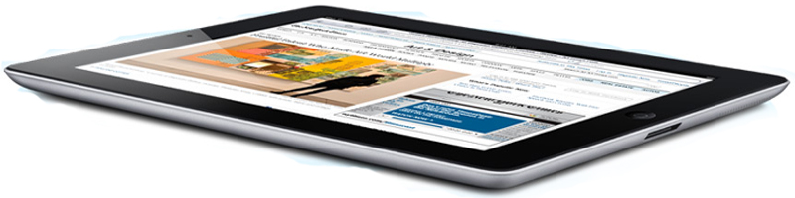
110.1.038 - Portable Device & Media Security Policy
Electronic information is portable and ePHI can be compromised by lost or stolen laptops, cell phones, CDs, thumb drives, etc.
Only Dignity Health approved smart phones and tablets may be used to access the Dignity Health network.
Limit the storage of PHI or other sensitive information on portable computers and media to the minimum necessary to perform the required tasks.
When PHI or confidential information is stored on a laptop or other portable media, maintain a record, mirror copy or backup on the Network.
Use appropriate safeguards when using, transporting or storing laptops or removable media.
57
Notes:
57

Slide 58
Removable Media Encryption
Password protection is NOT the same as encryption!
You are responsible to ensure all PHI or sensitive data on removable media like memory sticks, CDs or DVDs is properly encrypted and stored in safe location.
Never save PHI or Sensitive Information to a hard drive or removable media that is not properly encrypted.
Do NOT use the encryption software to encrypt devices like cell phones, cameras, music players or memory cards as they may be damaged or rendered unusable and/or unrecoverable.
Notes:
58

Slide 59
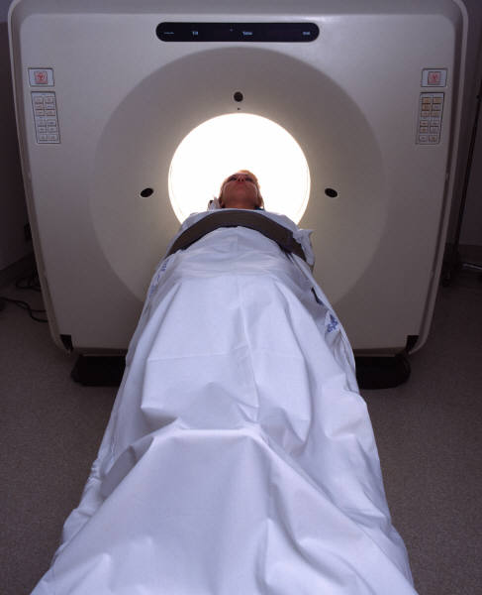
110.1.053 Medical Device Data Security Policy
It is the policy of Dignity Health to protect PHI that is stored on or transmitted by Medical Devices from unauthorized Uses and Disclosures.
Business or Technical owners shall complete a security assessment prior to procurement of a medical device, in order to document the safeguards used to protect PHI stored on or transmitted by the Medical Device.
Prior to implementation, the Business Owner shall complete a Privacy Impact Assessment.
Limit the storage of PHI on medical devices to the Minimum Necessary for treatment.
Maintain a backup of PHI stored on the device.
Immediately report any incident involving the loss, theft, or unauthorized use or access of a Portable Device or Portable Media.

Slide 60
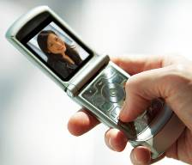
Personal Cell Phone Use
The use of personal cell phones or other camera-equipped devices must comply with the Network Usage Policy (110.1.037). The scope of this Policy includes smart phones, pagers, tablets and any handheld device.
All employees, physicians, and contractors are responsible for following policies and procedures to restrict the creating of or use of unauthorized digital images with a cell phone or other camera-capable device.
Notes:
60

Slide 61


Texting ePHI and Image Transmission
PHI sent via unsecured texting represents both a privacy and data security incident that may require patient notification and reporting to regulatory agencies.
Images sent via text leave a copy of the image on the server of the cellular carrier (i.e. AT & T, Verizon, etc.), the sender’s cell phone, and the recipient’s cell phone indefinitely.
Cell phone and data carriers are not business associates of Dignity Health and have no authorization to receive confidential data, and have no obligation to keep messages confidential.
61
61

Slide 62
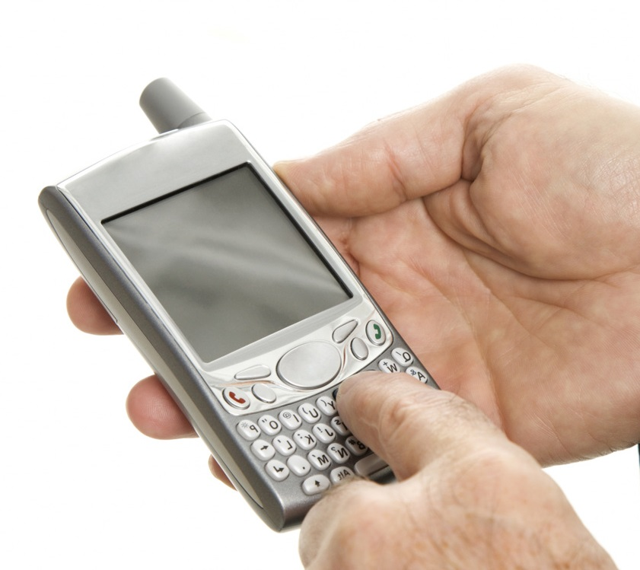
Lost or Stolen Portable Media
Call the IT Help Desk immediately to report the theft or loss of CD, flash drive, laptop or other portable device that contains PHI or sensitive information.
Call the IT Help Desk immediately to report theft or loss of your tablet or smart phone that you use to connect to the network.
The IT Security Team can send a “wipe” command to clear the memory on the device.
Do not cancel phone service with your provider before notifying the IT Help Desk because the “wipe” command cannot be sent.
Notes:
62

Slide 63
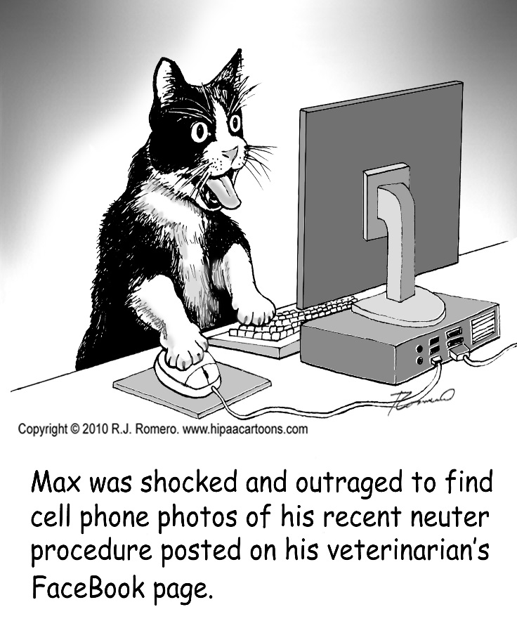
Social Media Guidelines
All employees are expected to conduct themselves in a manner that reflects integrity, as well as shows respect and concern for others, including the use of Social Media.
Never post confidential information or photo of a patient on the internet, even if it does not include a patient’s name.
Never discuss confidential information in public forums, chat room, text message or news group.
Inappropriate posts of confidential information or photos can seriously damage Dignity Health’s reputation, and result in individual liability for the responsible person(s).
Think about the consequences that may result from your communications.
Notes:
63

Slide 64













The Reality of Social Networks
Krystal posts information about a patient she treated in the ED on her Facebook page and how interesting the case was.
Level 1
Krystal
(1 person)
Level 2
Krystal’s Friends
(153 friends)
153 friends
Penny
Austin
Debbie
Daryl
Bill
Lisa
Rita
Level 3
Krystal’s Friends’ Friends (26,928 people)
26,928 people
Average 176 friends x Krystal’s 153 friends
= 26,928 people
Penny’s 237 Friends
Austin’s 124 Friends
Debbie’s 130 Friends
Daryl’s 305 Friends
Bill’s’ 176 Friends
Lisa’s 423 Friends
Rita’s 203 Friends
Level 4
Their Friends’ Friends (Over 4.7 million people)
Penny’s Friends’ 41,475 friends
Austin’s Friends’ 14,200 friends
Debbie’s Friends’ 22,750 friends
Daryl’s Friends’ 53,375 friends
Bill’s Friends’ 17,500 friends
4.7 million people
Lisa’s Friends’ 34,200 friends
Rita’s Friends’ 64,525 friends
Average 176 friends x 28,928 people
= 4,739,328 people
One person’s post grows exponentially based on “friending”.
64
Notes:
64
64
64

Slide 65

What Should You Do?
Bill wants to access work information stored on the Dignity Health network from his home to work on a project, using a laptop provided and supported by Dignity Health. Which of the following is a safe way for Bill to work remotely? (click on a response below)
Copy the information to a thumb / flash drive.
Use a Virtual Private Network (VPN) or other secure application that is approved by Dignity Health.
You should never access the Dignity Health network remotely.
65
Notes:
65

Slide 66
Try Again
Bringing data home on portable devices (like thumb drive) or in other physical form can be quite risky. A secure remote access system is the most secure way to access sensitive work data at home.
Try Again

Slide 67
Correct!
B. Use a Virtual Private Network (VPN) or other secure application that is approved by Dignity Health.
Never access the Dignity Health network from a public computer terminal like a cyber café or a hotel business office computer.
Continue
VPN or other secure method provided by Dignity Health IT should always be used. Bringing data home on portable devices (like thumb drive) or in other physical form can be quite risky. A secure remote access system is the most secure way to access sensitive work data at home.
67
Notes:
67

Slide 68
Reporting and Investigations
68

Slide 69

Reporting Systems
It is the right and responsibility of every member of Dignity Health’s workforce to immediately report any known or suspected violations of laws and regulations, the Standards of Conduct, Dignity Health policies and procedures and any unethical or other improper acts.
If corrective action is called for, Dignity Health will make appropriate corrections. All reports are taken seriously, reviewed and investigated promptly and employees are provided the option of anonymous reporting.
In some instances, the facility must report breaches to the Department of Health and Human Services (HHS) and notify the individuals affected.
Dignity Health will not permit retaliation against any employee who reports his or her concerns in good faith.

Slide 70
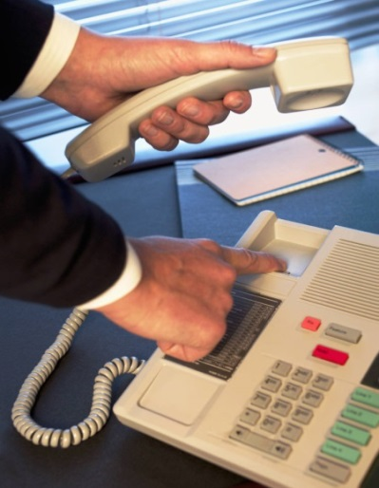
Reporting Systems (cont.)
Dignity Health has maintained a Disclosure Program (Hotline) pre-dating the CIA and it is required by the CIA.
Per the CIA, any report must be recorded in a disclosure log within 48 hours of receipt and shall include a summary of the report, the status of the respective internal review, and any corrective action taken.
You should report known or suspected violations of the law, policies or procedures to:
Your immediate supervisor / manager
Facility Compliance Professional (FCP)
Facility IT Site Director
Human Resources (for HR related issues)
Dignity Health Hotline (anonymous and confidential): 1-800-938-0031
Privacy.office@dignityhealth.org (for privacy and data security incidents)
Notes:
70

Slide 71

110.1.028 Investigation Response & Notification Policy
It is the policy of Dignity Health to promptly respond to, investigate and document all reports, complaints and inquiries relating to incidents.
Privacy Incident means any known or suspected breach of privacy or confidentiality involving PHI (Protected Health Information).
Security Incident means attempted (or successful) unauthorized access, use, disclosure, modification or destruction of information with system operations within the Dignity Health network. Also the loss of (or loss of control over) a Dignity Health owned or managed device and any other device that contains Dignity Health patient, employee or proprietary information.

Slide 72
Thank You
If you have any questions, please contact your local Service Area Compliance Director or Facility Compliance Professional.
This completes module 5. You will now take the module test.

